Slide 1

Red Team Level over 9000! Fusing .NET Payloads with Scripting Languages: Introducing BYOI Payloads (Bring Your Own Interpreter)

Slide 2

Whoami
Marcello (@byt3bl33d3r)
Work for BlackHills InfoSec
I gots some sparkly pieces of paper (a.k.a Certs)
https://www.github.com/byt3bl33d3r
Come see me after for some BHIS swag!

Slide 3

Agenda
Motivation
Some Key .NET Framework Concepts
Embedding Interpreters/Engines
Some BYOI Payload Examples & Demos
Weaponizing BYOI payloads in under 2 min
SILENTTRINITY
Detection
Q&A
© Black Hills Information Security
@BHInfoSecurity

Slide 4
Motivation
Offensive PowerShell tradecraft == Zombie
C# tooling migration has operational disadvantages
I really like scripting languages
I like developing ”weird” tools & tradecraft
I’m lazy
See n 5
© Black Hills Information Security
@BHInfoSecurity

Slide 5
WTH is a .NET Assembly??
© Black Hills Information Security
@BHInfoSecurity

Slide 6
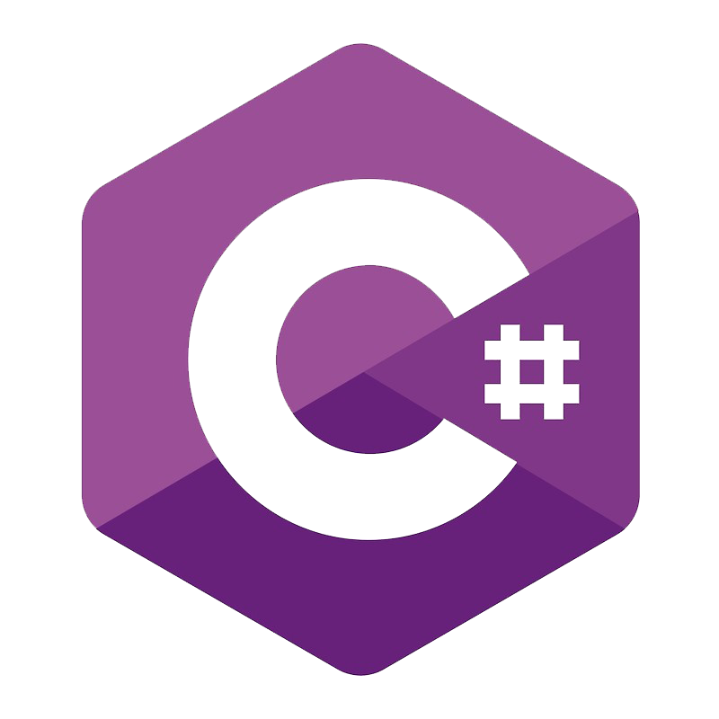
WTH is a .NET Assembly?
Both .NET assemblies !
© Black Hills Information Security
@BHInfoSecurity

Slide 7
WTH is a .NET Assembly?
.NET assemblies != Native EXEs/DLLs
© Black Hills Information Security
@BHInfoSecurity

Slide 8
.NET Languages
© Black Hills Information Security
@BHInfoSecurity

Slide 9

.NET Languages
F#
© Black Hills Information Security
@BHInfoSecurity

Slide 10
Assembly.Load()
© Black Hills Information Security
@BHInfoSecurity

Slide 11
Assembly.Load()
Accepts a byte array!
Equivalent of
Reflective DLL/PE injection!!
© Black Hills Information Security
@BHInfoSecurity

Slide 12
Go deeper!
No defenses here! (Yet)
All the defenses are here!
F#
© Black Hills Information Security
@BHInfoSecurity

Slide 13

Embedding Interpreters/Engines

Slide 14
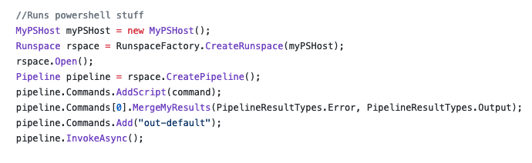
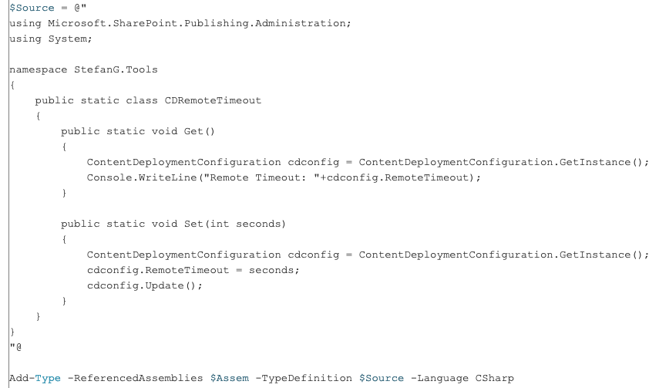
Embedding Interpreters/Engines
https://github.com/fullmetalcache/PowerLine
C# Code
https://blogs.technet.microsoft.com/stefan_gossner/2010/05/07/using-csharp-c-code-in-powershell-scripts/
© Black Hills Information Security
@BHInfoSecurity

Slide 15
Common Problems when Embedding Interpreters
Embedded language is going to require .NET > v4.0
The embedded language is going to need some DLLs to run (.NET assemblies)
The required assemblies are (usually) not installed by default
Depending on the “host” language, you’re going to need to resolve the needed DLLs on runtime before you start the actual Interpreter up
© Black Hills Information Security
@BHInfoSecurity

Slide 16
Loading the Required Assemblies
Which method you use depends heavily on the language you’re embedding into:
Because of Assembly.Load() we can do load them in-memory without touching disk
Passing the raw bytes of the assemblies to Assembly.Load() to load them into the current AppDomain
Hooking the AppDomain.Assembly.Resolve Event
Using Module Initializers
© Black Hills Information Security
@BHInfoSecurity

Slide 17
IronPython!
https://ironpython.net/
https://github.com/IronLanguages/ironpython2
Implementation of Python on top of the .NET framework
The module used to call native methods breaks when the language is embedded ☹
© Black Hills Information Security
@BHInfoSecurity

Slide 18
Embedding IronPython in C#/Powershell
https://github.com/byt3bl33d3r/OffensiveDLR
SharpSnek.cs & Invoke-Ironpython.ps1
IronPython requires 4 .NET assemblies to run:
IronPython.dll
IronPython.Modules.dll
Microsoft.Scripting.dll
Microsoft.Dynamic.dll
© Black Hills Information Security
@BHInfoSecurity

Slide 19
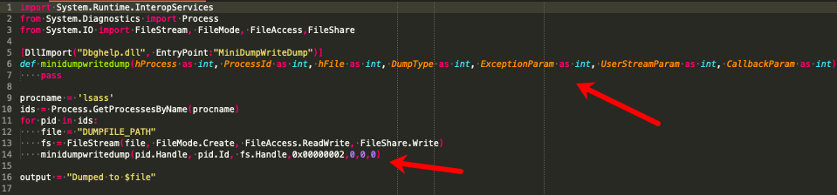
Boolang… OMFG
https://github.com/boo-lang/boo
Love Child between Python and C#
Syntax heavily inspired by Python
Can call Native Functions!!!! (no calls to csc.exe, everything is truly in memory!)
© Black Hills Information Security
@BHInfoSecurity

Slide 20
Embedding Boo In C#/PowerShell
https://github.com/byt3bl33d3r/OffensiveDLR
runBoo.cs & Invoke-Jumpscare.ps1
Boo requires 3 .NET assemblies to run:
BooLang.dll
BooLang.Compiler.dll
BooLang.Parser.dll
PowerShell:
We just call Assembly.Load() on the DLLs before initializing the Interpreter
C#:
We hook the Assembly.Resolve event

Slide 21
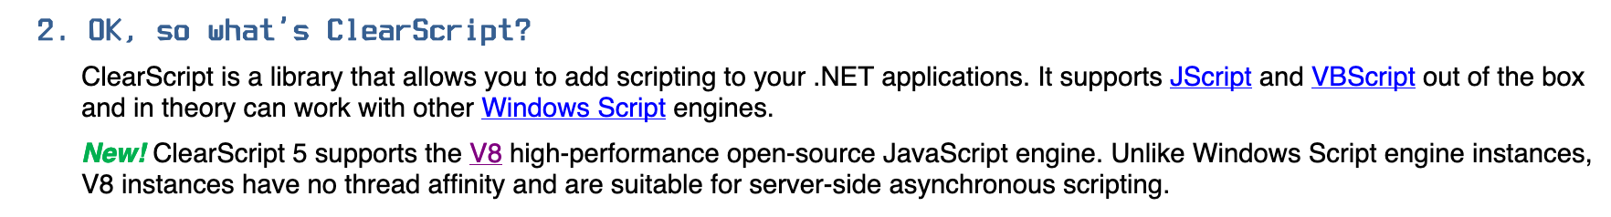
ClearScript ??
https://github.com/microsoft/ClearScript
https://microsoft.github.io/ClearScript/Tutorial/FAQtorial
It’s an official MS project!
© Black Hills Information Security
@BHInfoSecurity

Slide 22
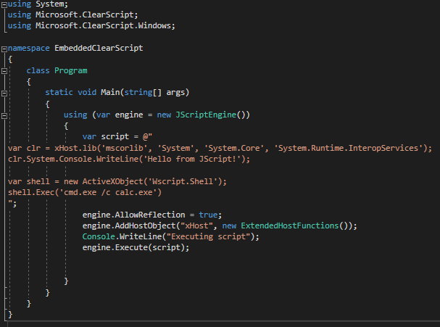
Embedding ClearScript in C#/PowerShell

Slide 23
Embedding ClearScript in C#/PowerShell
https://github.com/byt3bl33d3r/OffensiveDLR
Invoke-ClearScript.ps1
If you only want to run Jscript/VBScript you only need 1 Assembly (ClearScript.dll)
If you want to run the high-performance V8 Javascript engine you need 3-4 more

Slide 24
.NET Alchemy Recipes (Choose your favorite language!)
https://github.com/xanathar/moonsharp (Lua)
https://github.com/NLua/NLua (Lua)
https://github.com/sebastienros/jint (JavaScript)
https://github.com/RyanLamansky/dotnet-webassembly (WebAssembly)
https://github.com/microsoft/ClearScript (JScript, VBScript & JavaScript)
https://github.com/IronLanguages/ironpython2 (Python 2)
https://github.com/IronLanguages/ironpython3 (Python 3, still not ready)
https://github.com/IronLanguages/ironruby (Ruby)
https://github.com/boo-lang/boo (Boolang)
© Black Hills Information Security
@BHInfoSecurity

Slide 25
Bonus Round (Standalone .NET Language Compilers)
Some of these languages come with standalone compilers
If you use the standalone compilers to compile your scripts, the executable that it generates will run everywhere regardless of the .NET version
This is probably the easiest way to weaponize scripts quickly *without* embedding them
© Black Hills Information Security
@BHInfoSecurity

Slide 26
DEMO!
Weaponizing Boolang scripts in 2 min or less
© Black Hills Information Security
@BHInfoSecurity

Slide 27
https://github.com/byt3bl33d3r/SILENTTRINITY

Slide 28
v0.0.1 v0.1.0
From Beerware to Alpha!
Encrypted C2 comms & staging!
Boolang Support
CLI Tab completes all the things!
Customize the check-in interval of the sessions using the sleep command
There’s now a help menu option
© Black Hills Information Security
@BHInfoSecurity

Slide 29
Detection
© Black Hills Information Security
@BHInfoSecurity

Slide 30
Detection
Thank you Ryan Cobb!
@cobbr_io
.NET 4.8 has AMSI integration
CollectDotNetEvents.ps1 by @mattifestation
(https://gist.github.com/mattifestation/444323cb669e4747373833c5529b29fb)
krabsETW (https://github.com/Microsoft/krabsetw)
SilkETW (https://github.com/fireeye/SilkETW)
ModuleMonitor (https://github.com/TheWover/ModuleMonitor)
Luke Jenning at BlueHat v18 || Memory Resident Implants Code injection is alive and well
https://www.countercept.com/blog/hunting-for-silenttrinity/
© Black Hills Information Security
@BHInfoSecurity

Slide 31
Detection
No image backing

Slide 32
Coming Soon! (v0.2.0)
Complete rewrite to have a teamserver architecture (ala CStrike)
A lot more comms (already have DoH & WMI somewhat working)
Long Term Goal: CrackMapExec, Red Baron Integration, external c2 tool compatibility (Empire, Metasploit etc...), support for moar languages !
© Black Hills Information Security
@BHInfoSecurity

Slide 33
Q&A
© Black Hills Information Security
@BHInfoSecurity

Slide 34
Marcello (@byt3bl33d3r)
https://github.com/byt3bl33d3r
@BHinfoSecurity
https://www.blackhillsinfosec.com/
SILETTRINITY code is here:
https://github.com/byt3bl33d3r/SILENTTRINITY
Embedded Payload Code:
https://github.com/byt3bl33d3r/OffensiveDLR
© Black Hils Information Security
@BHInfoSecurity

